Slide 1

Group 11
Keya Patel Purna Haque Mohammed Sapin Mathew Varghese Thomas Tran | Zain Sayed Shilp Shah Rameen Masood Eric Zhang Nga Man (Mandy) Cheng
 | Nga Man (Mandy) Cheng
Demo Date: March 26, 2019
Github: https://github.com/mohammedsapin/RUStaying

Slide 2
Overview
Introduction to Our Application
Live Program Demonstration
Plans Moving Forward
Product Marketability
Problems Faced

Slide 3





Our Application
Offers hotel automation services
Optimize hotel functionality
Room booking and maintenance
Notes:
Our application which allows users to access the services and amenities within a hotel at the convenience of their fingertips. In addition, our application is designed to help hotel administrators optimize the functionality of staff, bookings, and maintenance, etc

Slide 4
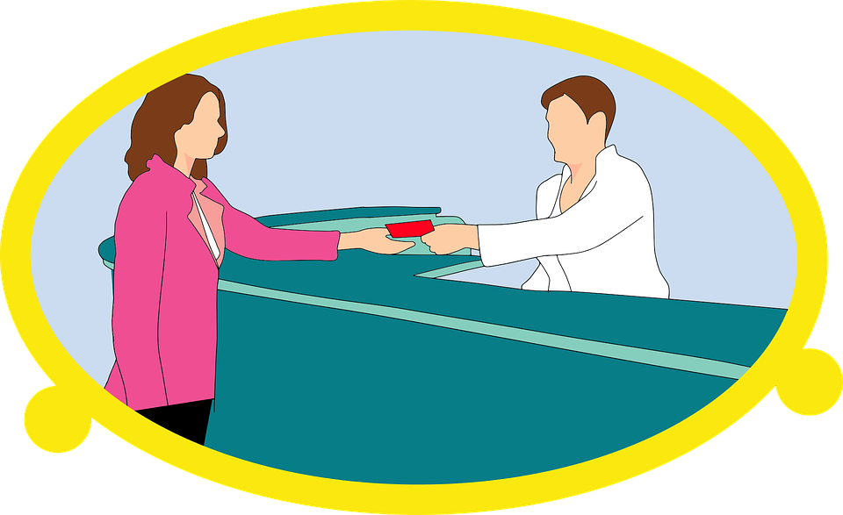
With our application, we offer both guests and hotel administers their own unique functions.
Administration
•Review Guest Data
•Request Status
•Room Availability
Guests
•Register
•Reservation
•Check In
•Room Service
•Concierge
•Maintenance
•Room Availability
Notes:
With our application, we offer both guests and hotel administers their own unique functions.
Administration
•Review Guest Data – allows admin to check the information of guests, given a specific name
•Request Status – change or mark guest’s request as “in progress” or “granted”
Guests & Administration
•Login – to log into a user account
•Logout – to log out of a user account
•Availability – allows admin to check if rooms are in use or vacant
Guests
•Register – allows user to register an account on the application
•Reservation – allows guest to make a reservation for aa room
•Check In – allows guest to check into the hotel
•Room Service – to call for room service
•Concierge – access front desk information through the application
•Maintenance – allows guest to call for maintenance

Slide 5
Problems Faced
Moving Forward
Sqlite to Firebase
Recycler View
Material design UI elements
Reading and writing data
Room Reservation functionality
Perform further testing on the functional features
More things to implement stated in Report 2 Part 3
Start to work on other milestones
Notes:
New Milestones to Work On:
-Implementing a Managerial Login with more security clearance
-Design pages for guest services
-Design pages for static FAQ
-Implement Forms for Requests and Feedbacks
Things Needed to Fix:
Shilp has it covered

Slide 6
Thank you
Any Questions?

